Slide 1
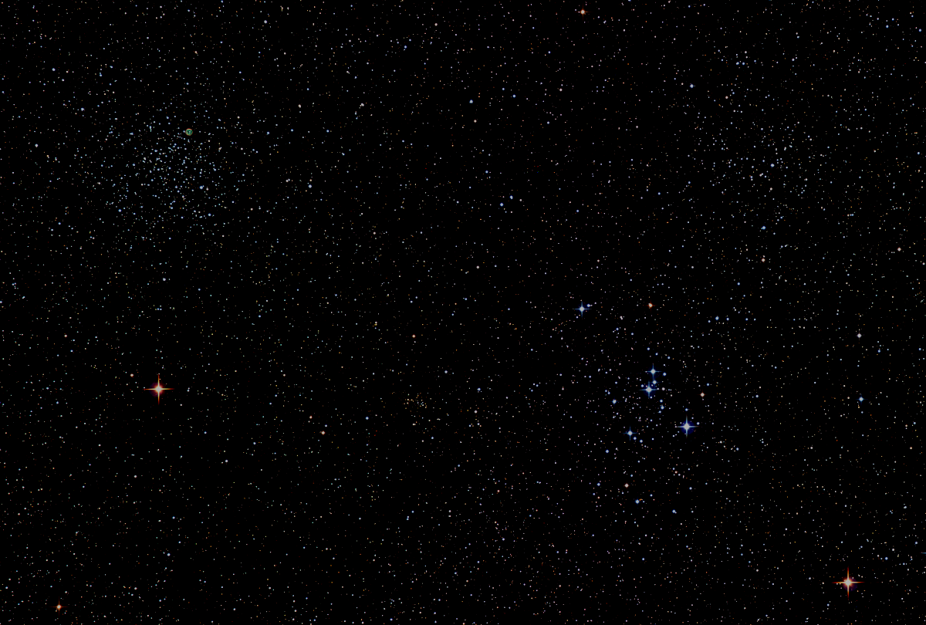

Howard
Astronomical
League
17
May 17th, 2018
Notes:
Howard Astronomical League, Oct 19, 2017

Slide 2
Introductions

Slide 3
Observatory Report Director: Joel Goodman
Donation by David and Leona Illig
Astrophysics 1200GTO Mount
Takahashi TAO-150 Telescope
SBIG STL-11000M CCD Camera
Two filter wheels
Plan
Install on Watson Pier

Slide 4
Select astrophotos by David Illig using the equipment that he has donated:
M37, the Triangulum Galaxy
The Galaxies M81 and M82 in Ursa Major
M104, the “Sombrero Galaxy” in Virgo
The Gamma Cygni Nebula in Hydrogen Alpha
http: www.primordial-light.com

Slide 5
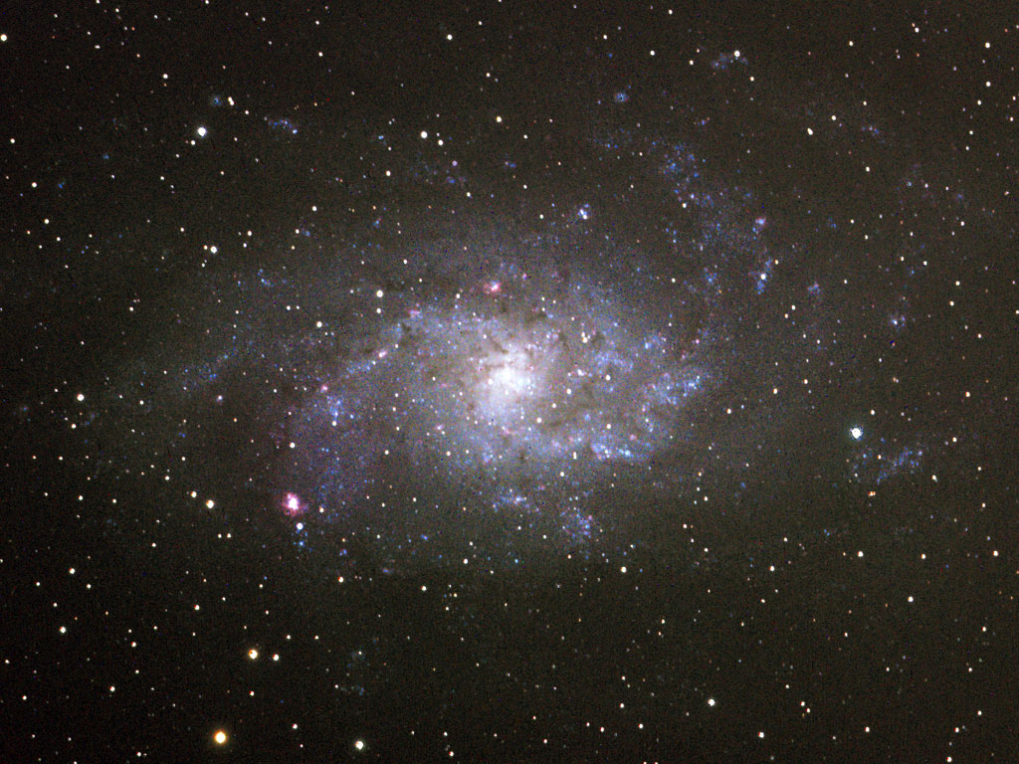

Slide 6
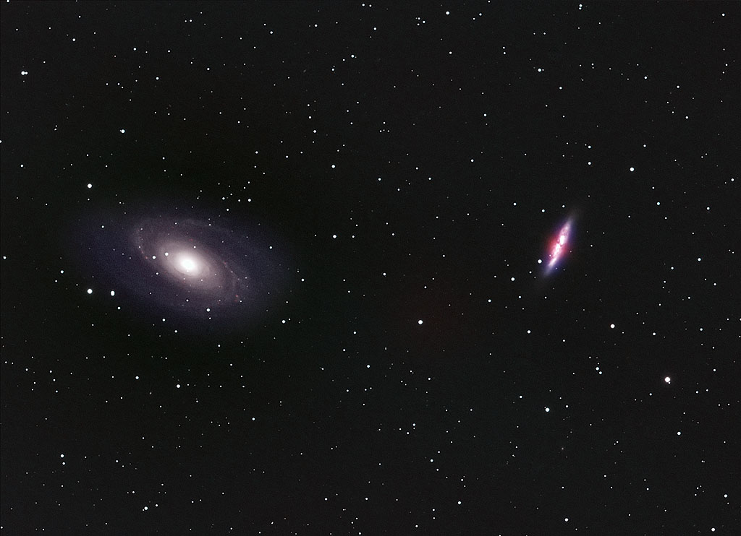

Slide 7
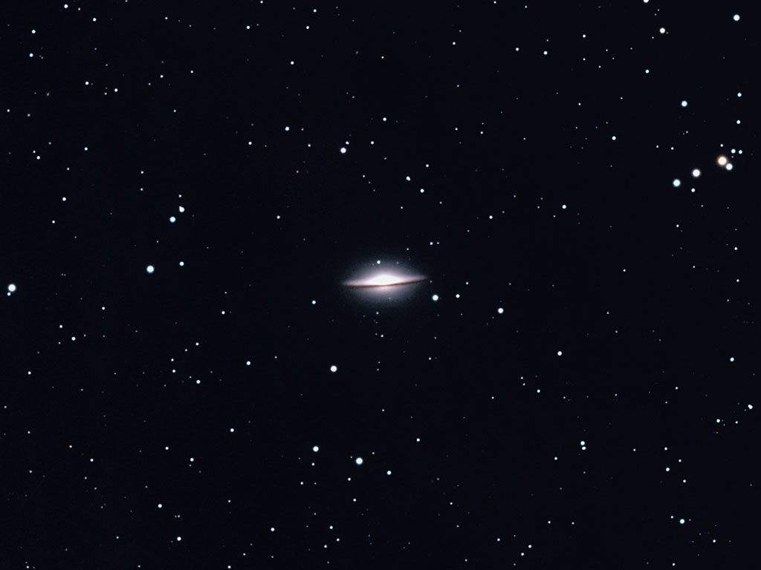

Slide 8
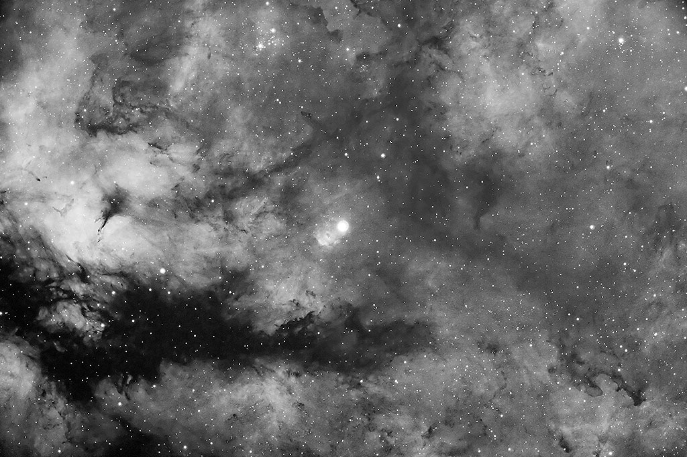

Slide 9
Upcoming Events
HAL Events – Alpha Ridge Park
May 19th at 8:00 – Public Star Party
June 9th at 8:30 – Members’ Star Party
June 16th at 8:30 – Public Star Party
Other Events
June 14th to 17th – Cherry Springs, PA Star Party

Slide 10
Three Oppositions in 79 Days!
Jupiter: May 8th
Saturn: June 27th
Mars: July 27th

Slide 11
Venus
15 Aug – Dichotomy (Half phase)
17 Aug – Greatest elongation east
25 Sep – Greatest brightness
26 Oct – Inferior solar conjunction

Slide 12
This Evening’s Speaker
Dr. Joe Bohannon
HAL Member
Astrophotography from Down Under
Notes:
It is my distinct pleasure to introduce Dr. Bindu Rani. She has been a Postdoctoral Fellow at NASA/Goddard Space Flight Center since July 2016, and will continue to hold that post until June 2019. She was also a Postdoctoral Fellow at the Max-Planck-Institut für Radioastronomie Bonn, Germany from February 2014 to June 2016. She has held visiting scientist and researcher positions at the Korean Very Long Baseline Interferometry Network of the Korea Astronomy and Space Science Institute, and The Gra-dig-nan Bordeaux Nuclear Research Center in France. Dr. Rani has experience in Gamma-ray, X-ray, optical, and radio astronomy. Her optical observational experience includes use of the 1.04 meter telescope at AIRES, Na-in-i-tal, India, and the 1.20 meter telescope at Mount Abu, India.
Among her many achievements, Dr. Rani was awarded the Otto Hahn Medal for outstanding scientific achievements by the Max Planck Society in 2015. She holds Bachelor and Master of Science degrees from University of Delhi and Da-yan-and University, respectively, in India. Last, and certainly not least, Dr. Rani completed her Ph.D at Max-Planck-Institut für Radioastronomie and University of Köln, both in Germany in 2013.

Slide 13
Member’s astrophotos
and sketches

Slide 14
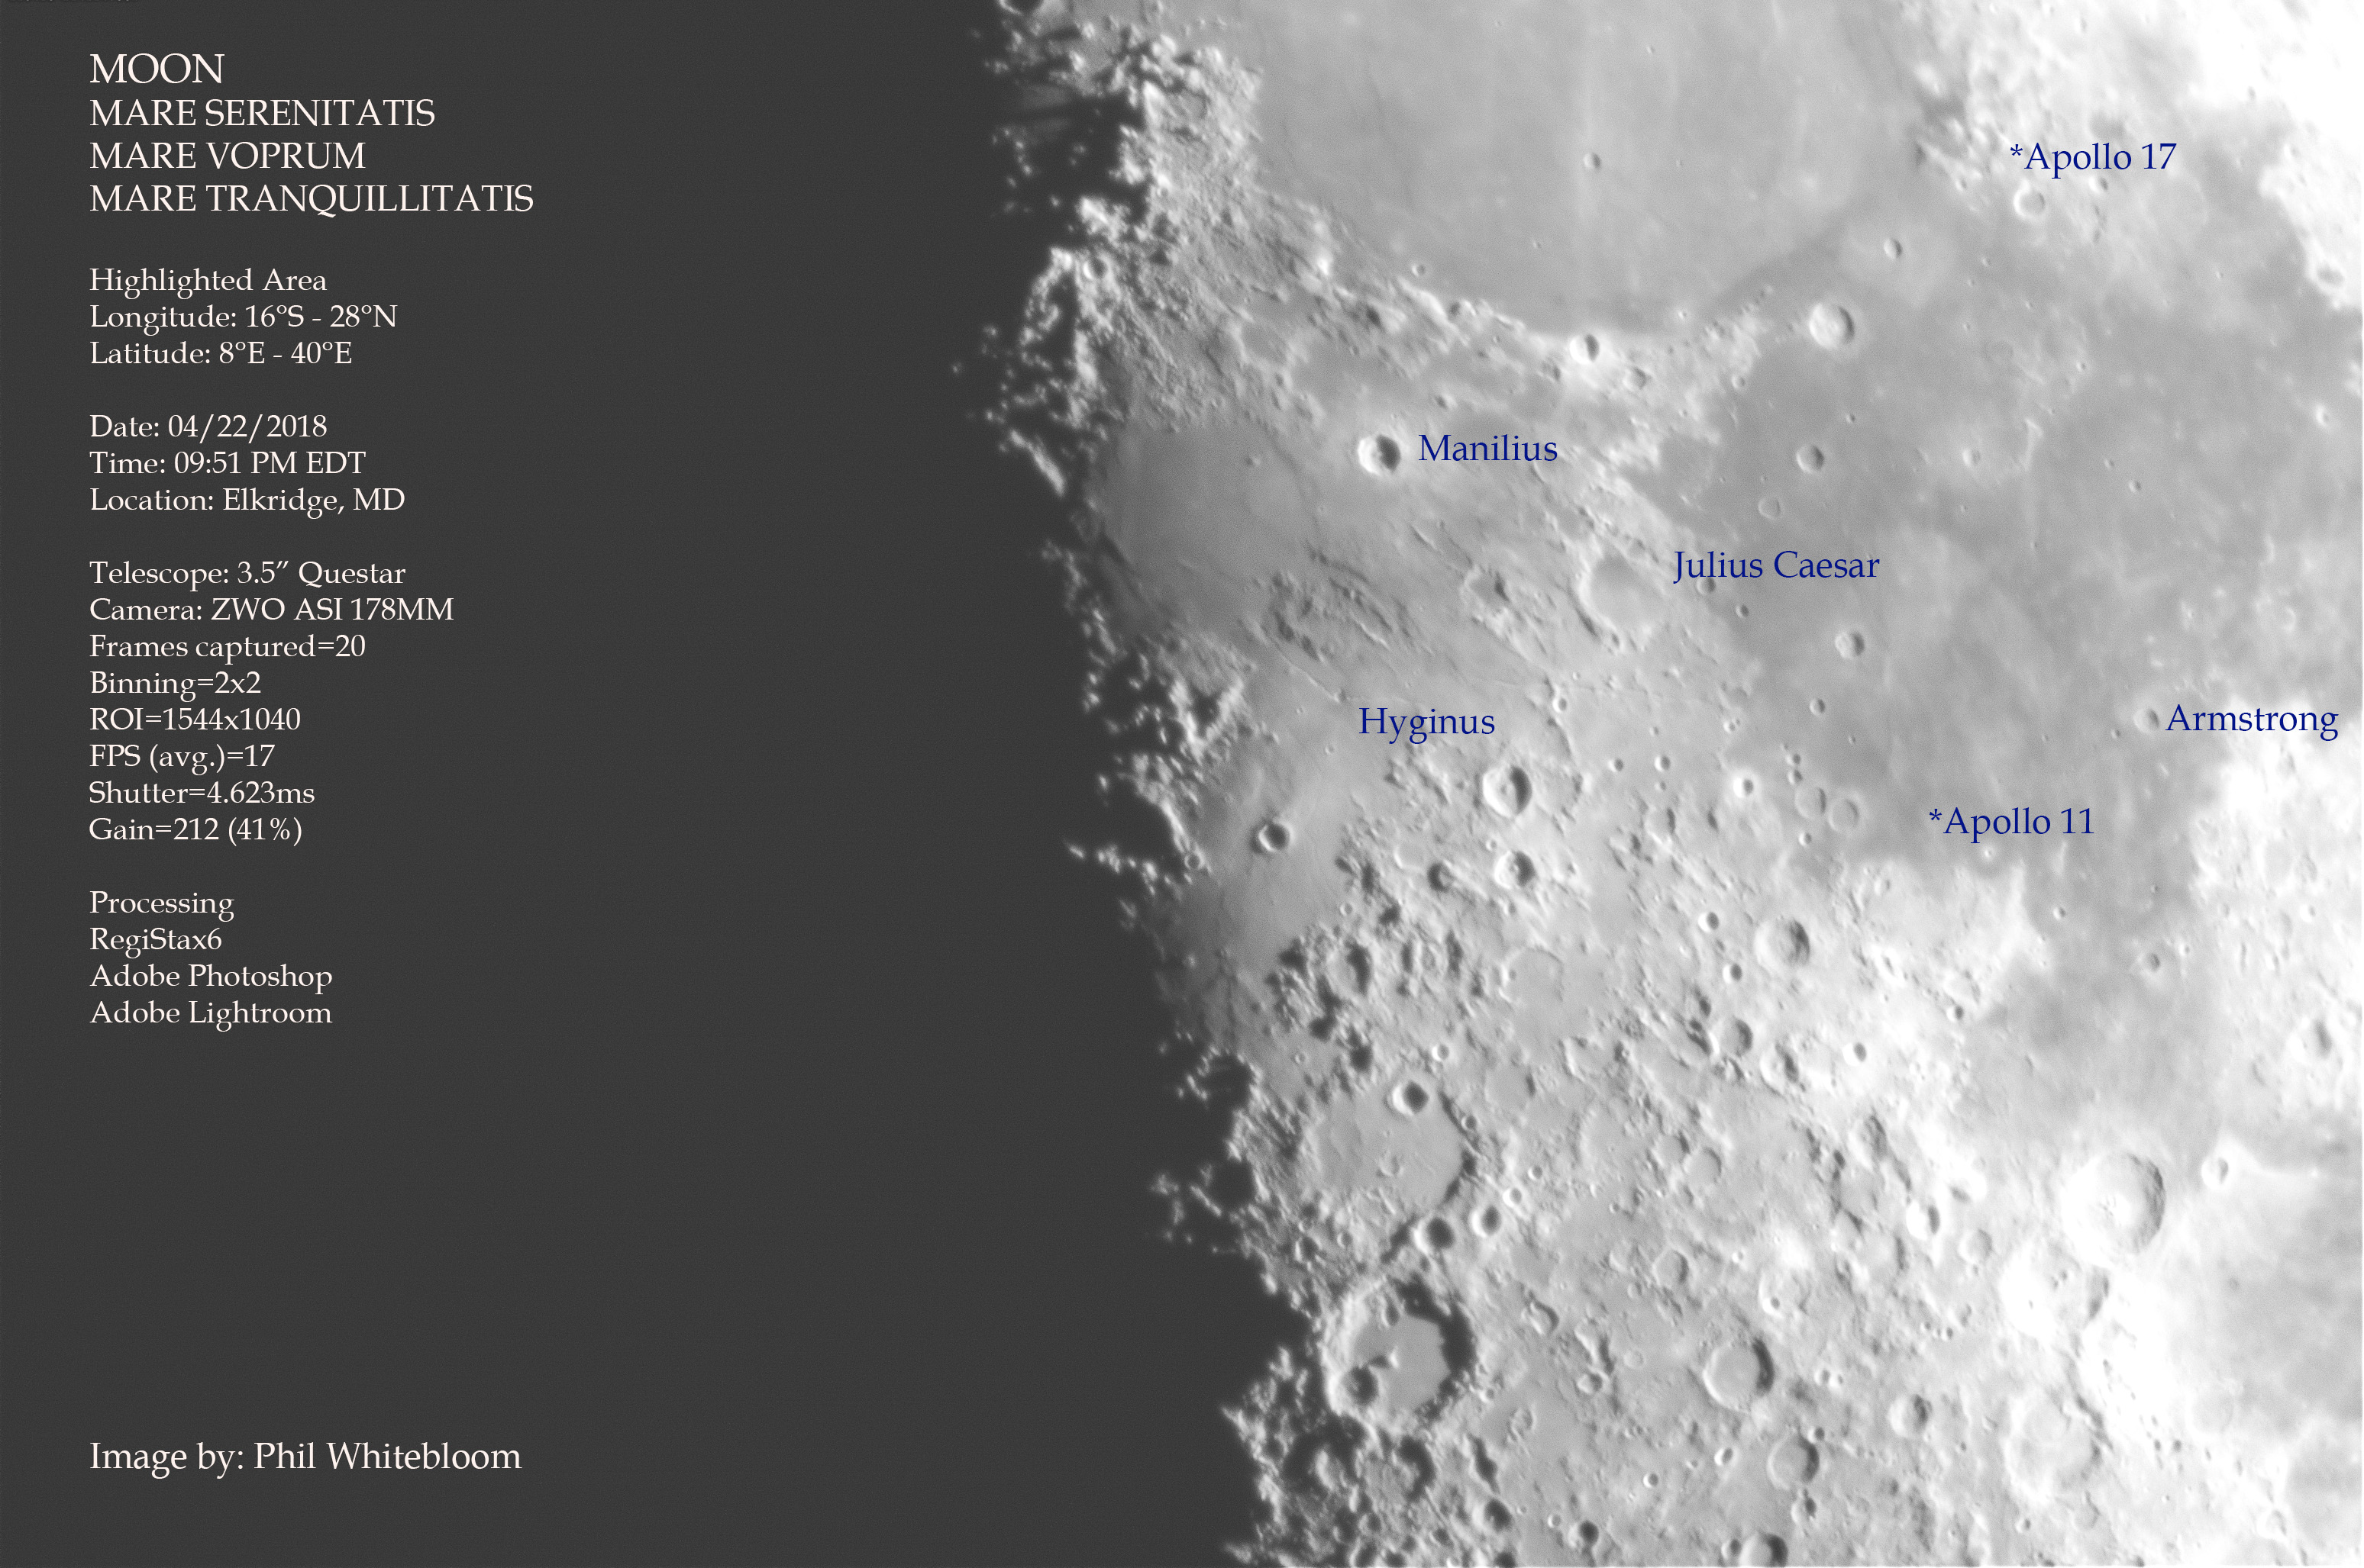

Slide 15
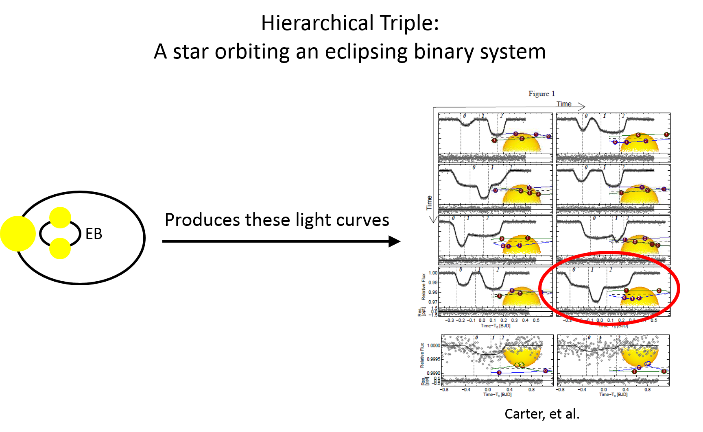
Dennis Conti

Slide 16
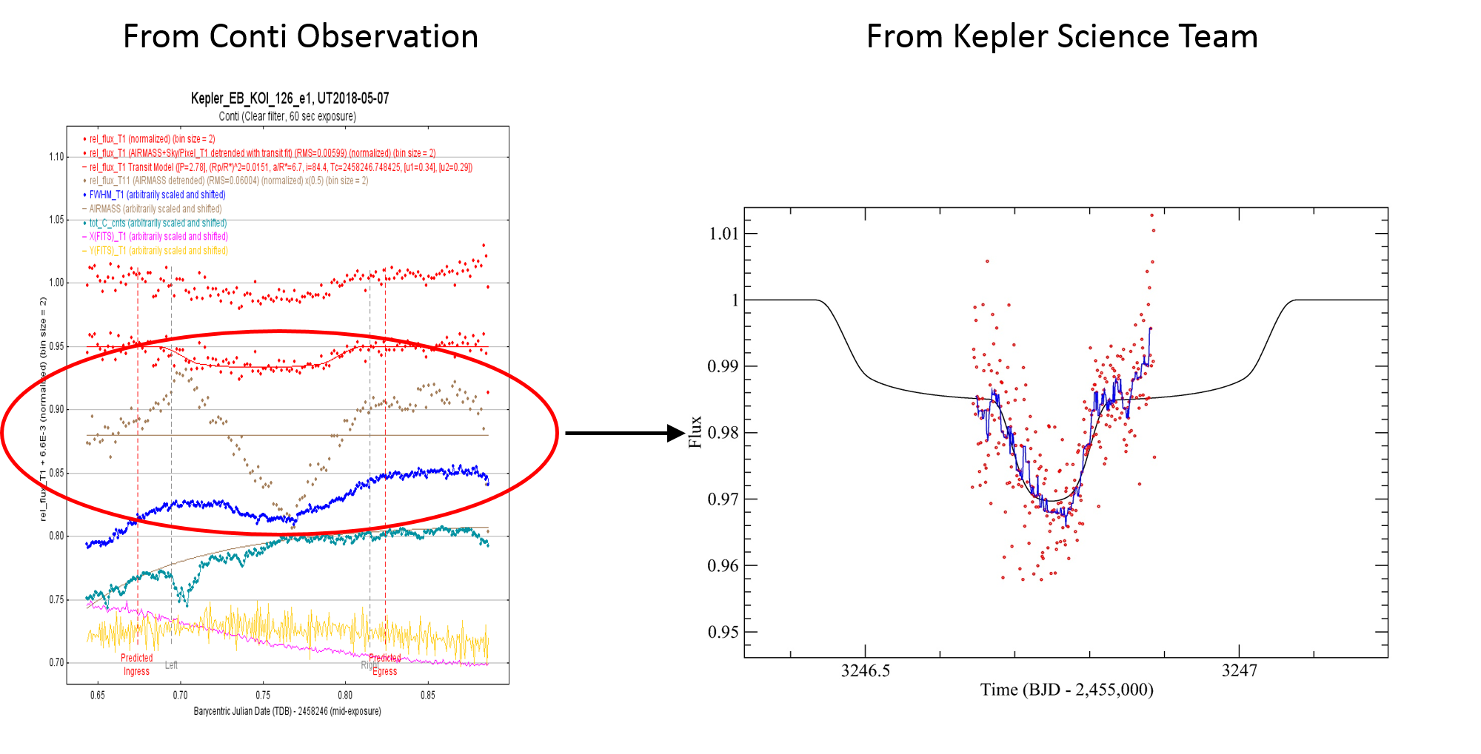

Slide 17
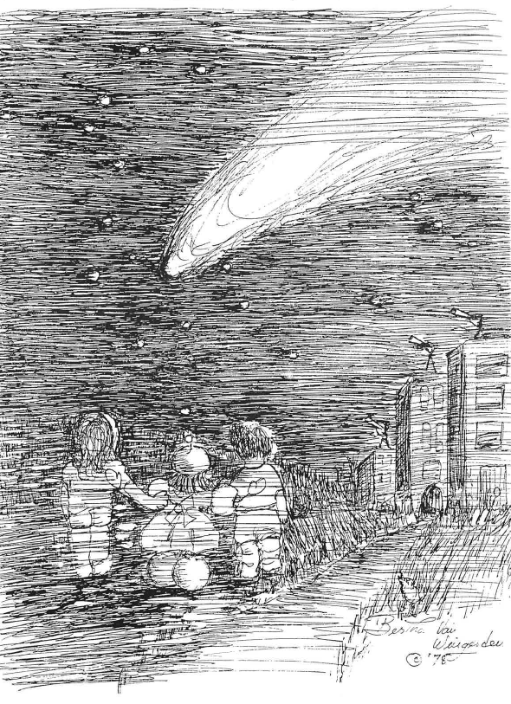
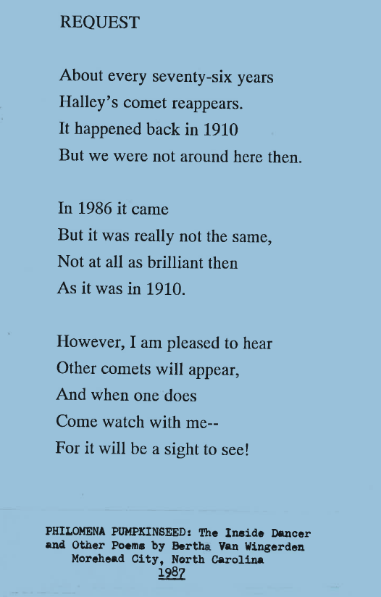

Slide 18
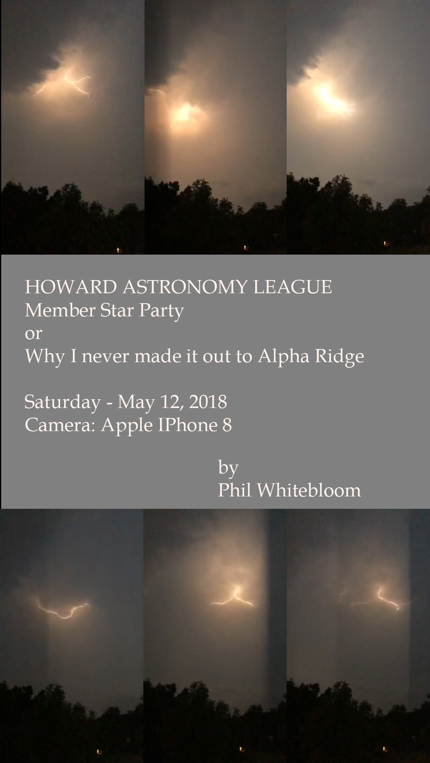

Slide 19
Thank You!
Next month’s meeting is on Thursday, June 21st 2018 at 7 PM
(Summer Solstice!)
Richard Orr
HAL Member
Tips on Observing Mars During the 2018 Opposition

